Slide 1
Integrated Business Planning
MGMT 324
Exploring the Political Frame
Susan Kates
skates@my.centennialcollege.ca
Notes:
1

Slide 2
Agenda
Short review
  Frame?
  What is the structural frame?
  What is the HR frame?
  Daniel Pink’s Theory of Motivation
Intro to The Political Frame
Exploring Sources of Power
Notes:
2

Slide 3
Review
What is re-framing?
  Someone in your family (brother, sister, parent) is angry because of something that happened at their workplace. Sometimes, the company has really good times and there is a lot of hours and overtime available. However, for the next three months, business will be slow. To cut costs without cutting jobs, management has decided to give employees every other Friday off … without pay.
  You suggest to your family member that they might consider re-framing the situation.
  First, you have to explain re-framing.
  Second, describe how would you help your family member re-frame this situation.

Slide 4
Review
The Structural Frame
  You meet a friend on the bus home from campus. She / he tells you a story from their workplace. You say, “Sounds like the manager is very structural.” Your friend says “Huh?” How do you explain the structural frame to your friend in three sentences or less?

Slide 5
Review
The Human Resource Frame
  You have been asked to find some volunteers to staff a CCSAI event. The event is a free concert and there are many jobs to take on. Some jobs involve interaction with concert-goers (i.e. ushering), some jobs are very physical (i.e. stage set-up/take down), and some jobs are more organizational/behind the scenes (booking space, arranging security, etc.)
  Can you use your knowledge of the HR frame to help you approach this task? How?

Slide 6
Power, Conflict and Coalitions
Assumptions of the Political Frame
Organizations as Coalitions
Power and Decision-Making
Authorities and Partisans
Sources of Power
Conflict in Organizations

Slide 7
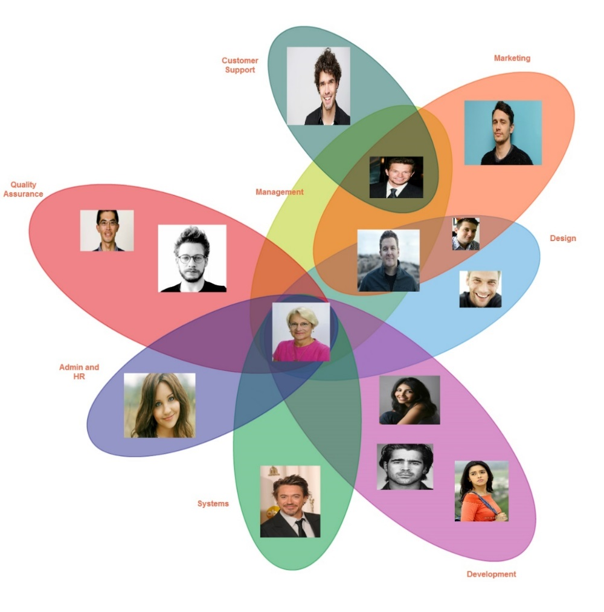
Organizations as Coalitions
  Coalitions rather than pyramids
  Multiple players with divergent interests

Slide 8
Power and Decision-Making
  Gamson: Authorities and partisans
    Authorities make binding decisions
      Agents of social control
      Seek to maintain authority; their position depends on it
    Partisans are subject to authorities’ decisions; they will support or question authority depending on decisions affect their interests
      Recipients of control from authorities
      Support authority when satisfied, but may challenge when not

Slide 9
Conflict in Organizations
Conflict is natural and inevitable: organizations can have too much or too little
Political frame focuses on strategy and tactics for dealing with conflict
Forms of organizational conflict
  Hierarchical conflict
  Horizontal
  Cultural

Slide 10
Summary
The political frame sees a very different world from the traditional view of organizations
  Traditional: organizations are hierarchies, run by legitimate authorities who set goals and manage performance
  Political view: organizations are coalitions whose goals are determined by bargaining among multiple contenders
Politics can be nasty and brutish, but constructive politics is possible and necessary for organizations to be effective

Slide 11
Sources of Power (p. 196-200)
Position power (authority)
Control of rewards
Coercive power
Information and expertise
Reputation
Personal power
Alliances and networks
Access and control of agenda
Framing: control of meaning and symbols
Reciprocation
Commitment and consistency
Social proof
Liking
Authority
Scarcity

